Slide 1

Bike Sharing Demand Forecast use of a city bikeshare system
陳紫淇

Slide 2
目標
預測城市裡每小時單車被租借的數量(count)

Slide 3
載入套件
import pandas as pd
import numpy as np
#繪圖套件
import matplotlib.pyplot as plt
import seaborn as sns

Slide 4
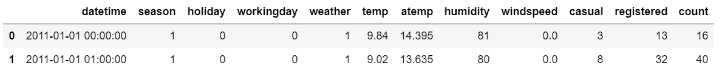
載入資料
train_df = pd.read_csv('train.csv')
test_df = pd.read_csv('test.csv')
train_df.head(2)
#holiday (禮拜六禮拜天不算)
#workingday 禮拜一到五
#season ---> 1 =春天，2 =夏天，3 =秋天，4 =冬天
#weather ---> 1>4 = 好>差
日期時間 季節 假日 工作天 天氣 溫度 體感溫度 相對溼度 風速 未註冊 已註冊 所有租車的人

Slide 5
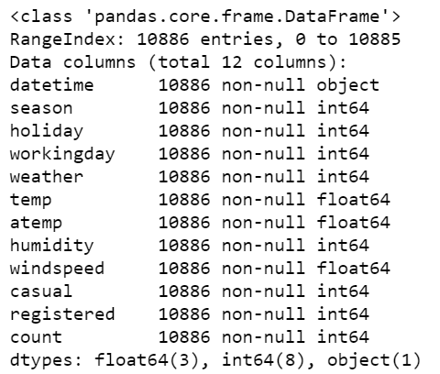
檢查資料
train_df.info()

Slide 6
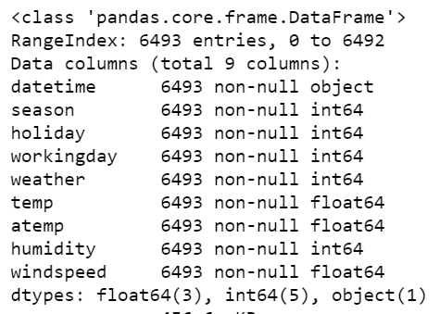
檢查資料
test_df.info()

Slide 7
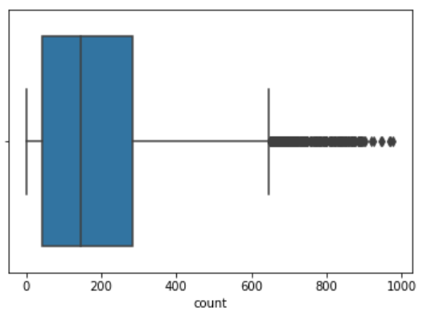
Feature Engineering-count
sns.boxplot(train_df['count'])
plt.show()

Slide 8
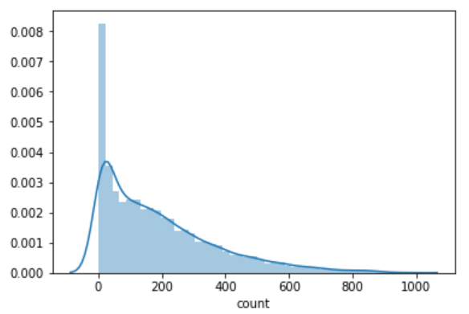
Feature Engineering-count
sns.distplot(train_df['count'])
plt.show()

Slide 9
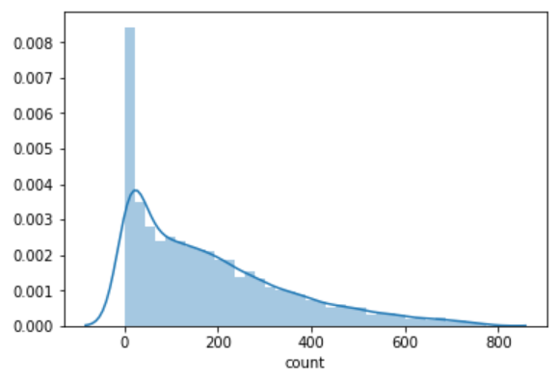
Feature Engineering-count
cnt=train_df['count'].values
q99=np.percentile(cnt,[99]) #第99百分位數
#去掉比第99百分位數還要大的資料
train_df=train_df[train_df['count']<q99[0]]
sns.distplot(train_df['count'])
plt.show()

Slide 10
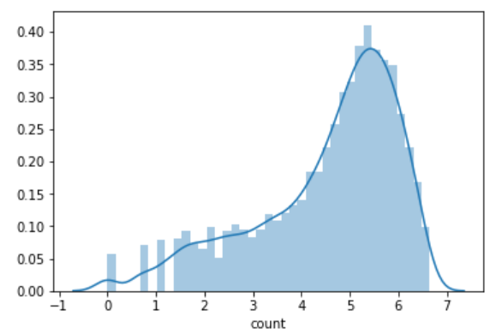
Feature Engineering-count
#以e為底取log 把數字變小
train_df['count']=train_df['count'].apply(lambda x:np.log(x))
sns.distplot(train_df['count'])
plt.show()
也可以用開根號、box-cox等方式轉換

Slide 11
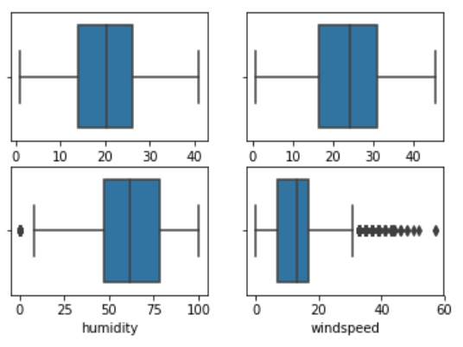
Feature Engineering-有大小之分的數據
cont_names=['temp','atemp','humidity','windspeed']
i=0
for name in cont_names:
i=i+1
plt.subplot(2,2,i)
sns.boxplot(name,data=train_df)
plt.show()
Temp、atemp、humidity 分布正常
Windspeed 分布異常

Slide 12
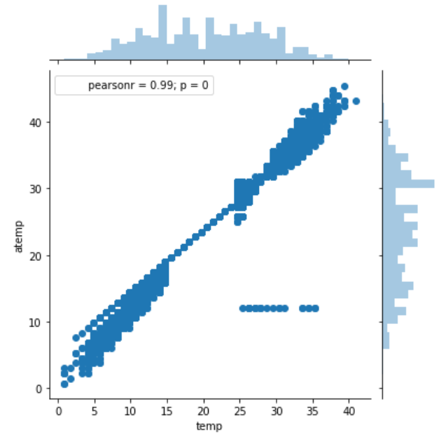
Feature Engineering-有大小之分的數據
sns.jointplot('temp','atemp',data=train_df)
plt.show()
變量之間的相關程度高會造成多重共線性
多重共線性會使model的預測不準
所以為了避免多重共線性，刪除其中一種數據

Slide 13
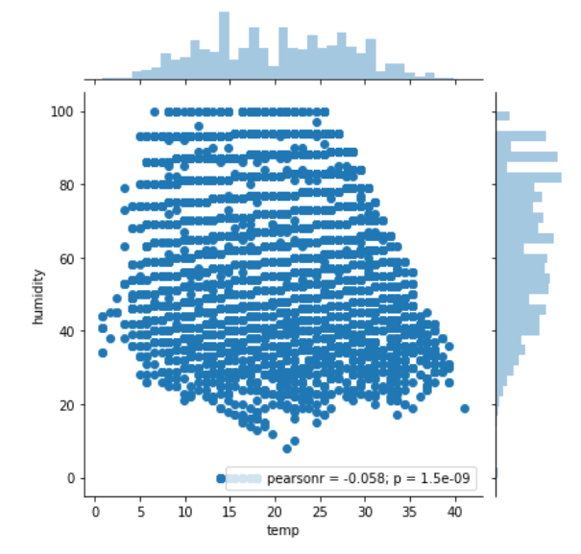
Feature Engineering-有大小之分的數據

Slide 14
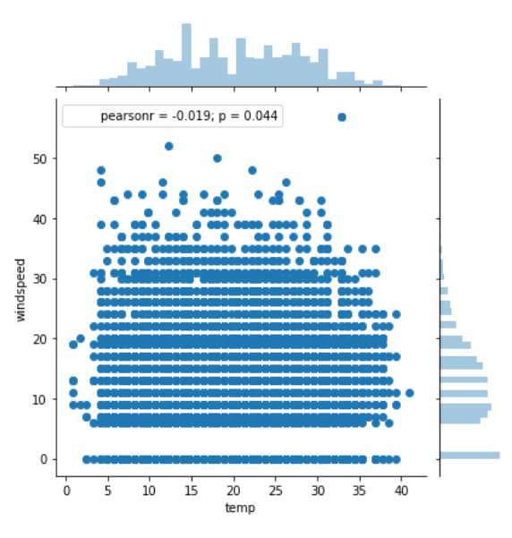
Feature Engineering-有大小之分的數據

Slide 15
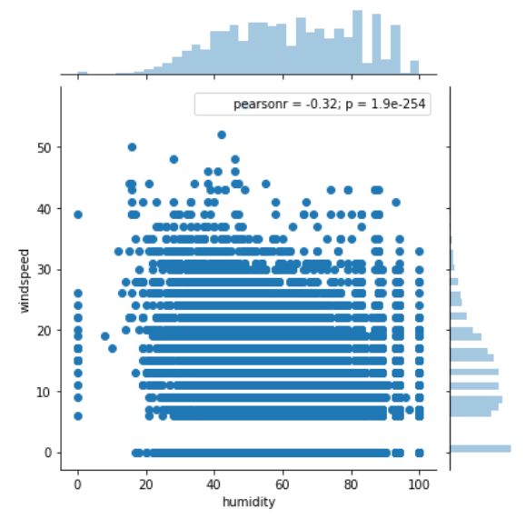
Feature Engineering-有大小之分的數據

Slide 16
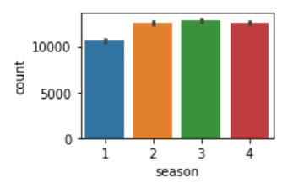
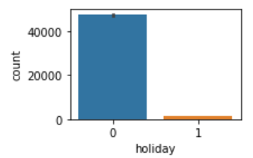
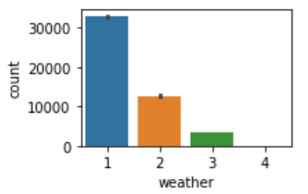
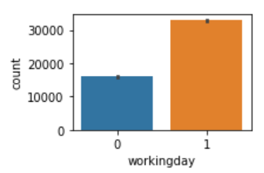
Feature Engineering-沒有大小之分的數據
#租借總數
cat_names=['season', 'holiday', 'workingday', 'weather']
i=1
for name in cat_names:
plt.subplot(2,2,i)
sns.barplot(x=name,y='count',data=train_df,estimator=sum)
i=i+1
plt.show()

Slide 17
Feature Engineering-處理日期
from datetime import datetime
train_df['datetime']=train_df['datetime'].apply(lambda x:datetime.strptime(x,'%Y-%m-%d %H:%M:%S'))
time_series_df=train_df
time_series_df.index=train_df['datetime'] #把index改成datetime來顯示

Slide 18
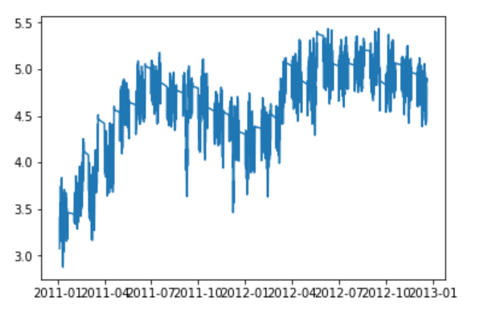
Feature Engineering-處理日期
#每60筆資料相加平均 方便觀察變化
plt.plot(time_series_df['count'].rolling(60).mean())
plt.show()
租車的人隨著時間愈來愈多，
所以日期的資料要保留

Slide 19
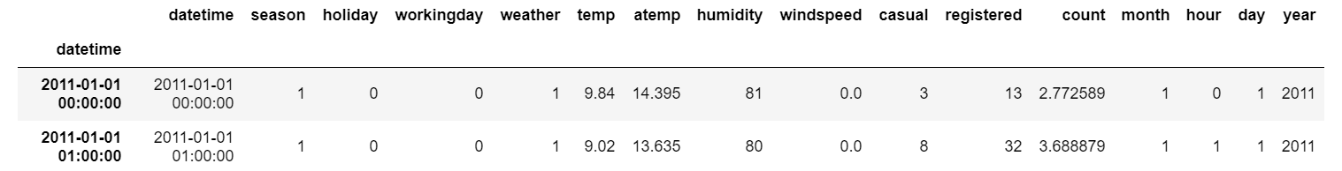
Feature Engineering-處理日期
new_df=train_df
new_df['month']=new_df['datetime'].apply(lambda x:x.month)
new_df['hour']=new_df['datetime'].apply(lambda x:x.hour)
new_df['day']=new_df['datetime'].apply(lambda x:x.day)
new_df['year']=new_df['datetime'].apply(lambda x:x.year)
new_df.head()

Slide 20
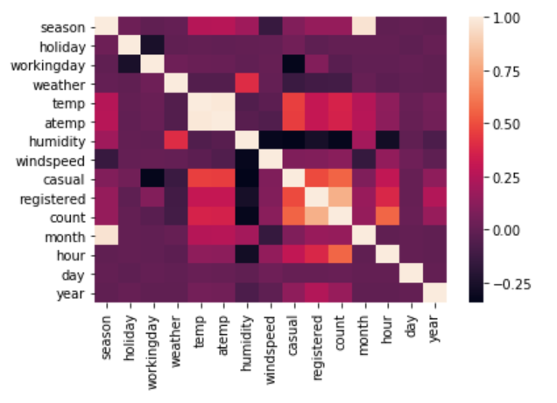
Feature Engineering-相關係數
sns.heatmap(new_df.corr())
plt.show()
刪除:
temp
windspeed(相關性低)
day(相關性低)

Slide 21
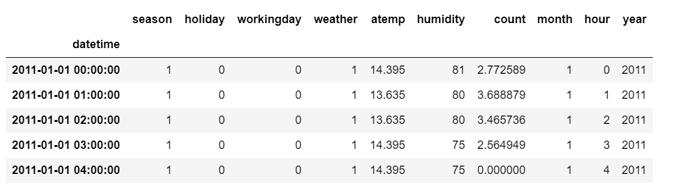
Feature Engineering-相關係數
final_df=new_df.drop(['datetime','temp','windspeed','casual','registered','day'], axis=1)
final_df.head()

Slide 22
Feature Engineering-編碼
#get_dummies -> 進行one-hot編碼
#當離散特徵的值之間沒有大小的意義時使用
weather_df=pd.get_dummies(new_df['weather'],prefix='w',drop_first=True)
year_df=pd.get_dummies(new_df['year'],prefix='y',drop_first=True)
month_df=pd.get_dummies(new_df['month'],prefix='m',drop_first=True)
hour_df=pd.get_dummies(new_df['hour'],prefix='h',drop_first=True)
season_df=pd.get_dummies(new_df['season'],prefix='s',drop_first=True)
final_df=final_df.join(weather_df)
final_df=final_df.join(year_df)
final_df=final_df.join(month_df)
final_df=final_df.join(hour_df)
final_df=final_df.join(season_df)
final_df.head()

Slide 23
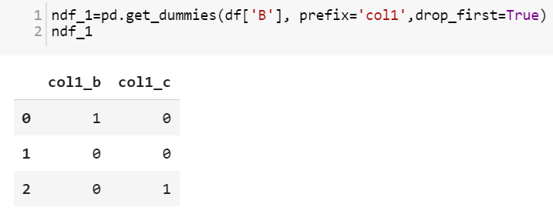
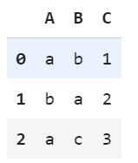
Feature Engineering-編碼

Slide 24
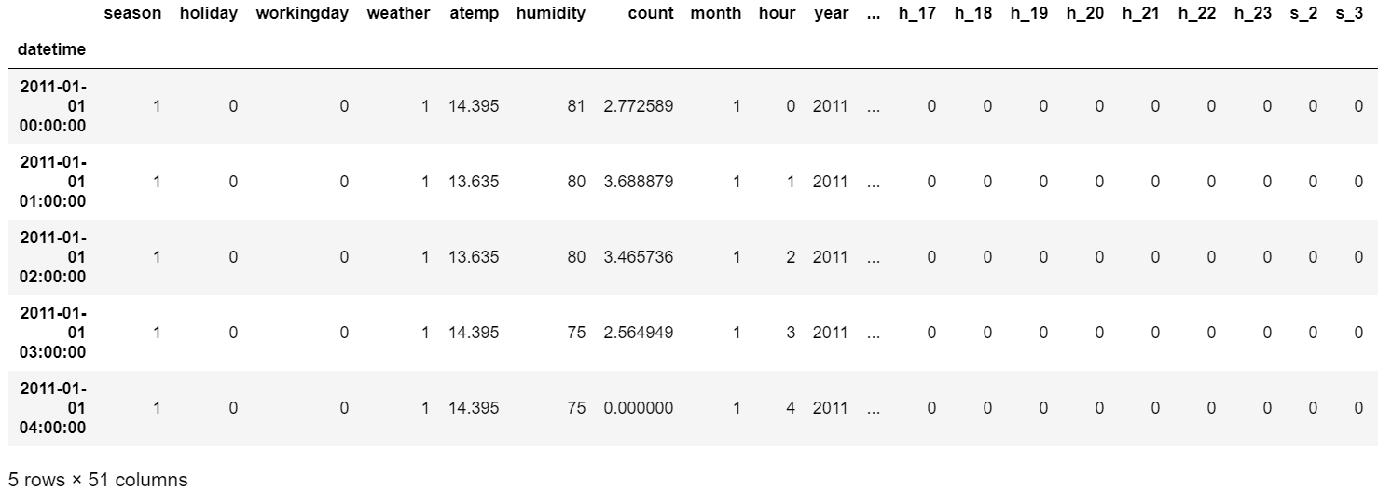
Feature Engineering-編碼

Slide 25
Feature Engineering-處理測試資料
new_df=test_df
new_df['datetime']=new_df['datetime'].apply(lambda x:datetime.strptime(x,'%Y-%m-%d %H:%M:%S'))
new_df['month']=new_df['datetime'].apply(lambda x:x.month)
new_df['hour']=new_df['datetime'].apply(lambda x:x.hour)
new_df['day']=new_df['datetime'].apply(lambda x:x.day)
new_df['year']=new_df['datetime'].apply(lambda x:x.year)
new_df=new_df.drop(['datetime','temp','windspeed','day'], axis=1)

Slide 26
Feature Engineering-處理測試資料
weather_df=pd.get_dummies(new_df['weather'],prefix='w',drop_first=True)
yr_df=pd.get_dummies(new_df['year'],prefix='y',drop_first=True)
month_df=pd.get_dummies(new_df['month'],prefix='m',drop_first=True)
hour_df=pd.get_dummies(new_df['hour'],prefix='h',drop_first=True)
season_df=pd.get_dummies(new_df['season'],prefix='s',drop_first=True)
new_df=new_df.join(weather_df)
new_df=new_df.join(yr_df)
new_df=new_df.join(month_df)
new_df=new_df.join(hour_df)
new_df=new_df.join(season_df)

Slide 27
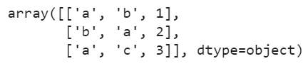
Xgboost
#.values 是用來把dataframe變成單純的array
X=final_df.drop("count",axis=1).values Y=final_df["count"].values
import xgboost as xg
from sklearn.model_selection import GridSearchCV #自動找參數用

Slide 28
Xgboost-參數
1、eta [default=0.3]
學習率，相當於sklearn中的learning_rate，常見的設置範圍在0.01-0.2之間
2、min_child_weight [default=1]
葉節點的最小權重值
3、max_depth
樹的最大深度，通常取值範圍在3-10
4、gamma [default=0]
分裂收益閾值
即用來比較每次節點分裂帶來的收益，有效控制節點的過度分裂

Slide 29
Xgboost-參數
5、subsample [default=1]
採樣比例，與sklearn中的參數一樣，即每顆樹的生成可以不取全部樣本，
這樣可以控制模型的過擬合
通常取值範圍0.5-1
6、colsample_bytree [default=1]
特徵採樣的比例（每棵樹），即每棵樹不使用全部的特徵，控制模型的過擬合
通常取值范围0.5-1

Slide 30
GridSearchCV-參數
estimator：所使用的分類器
param_grid：值為字典或者列表，即需要最優化的參數的取值
cv :交叉驗證參數，默認None，使用三折交叉驗證。
n_jobs: 並行數，int：個數,-1：跟CPU核數一致, 1:默認值。

Slide 31
Xgboost-調參數
def grid_search():
print ('lets go')
#要使用GPU在這裡加上tree_method='gpu_hist'
xgr=xg.XGBRegressor(tree_method='gpu_hist',max_depth=6,
min_child_weight=6,gamma=0.0)
xgr.fit(X,Y)
parameters=[{'max_depth':[8,9,10,11,12],
'min_child_weight':[4,5,6,7,8]}]

Slide 32
Xgboost-調參數
parameters=[{'max_depth':[8,9,10,11,12],
'min_child_weight':[4,5,6,7,8]}]
parameters=[{'gamma':[i/10.0 for i in range(0,5)]}]
parameters=[{'subsample':[i/10.0 for i in range(6,10)],
'colsample_bytree':[i/10.0 for i in range(6,10)]}]

Slide 33
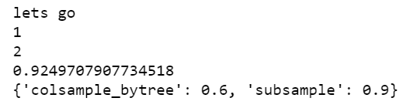
Xgboost-調參數
grid_search= GridSearchCV(estimator=xgr, param_grid=parameters,
cv=10,n_jobs=-1)
print (1)
grid_search=grid_search.fit(X,Y)
print (2)
best_accuracy=grid_search.best_score_
best_parameters=grid_search.best_params_
print (best_accuracy)
print (best_parameters)

Slide 34
Xgboost-train
#使用剛剛調好的參數再訓練一次
xgr=xg.XGBRegressor(tree_method='gpu_hist',max_depth=8,min_child_weight=8,gamma=0.0,colsample_bytree=0.6,subsample=0.9)
xgr.fit(X,Y)
y_output=xgr.predict(X_test)
#儲存資料
op=pd.DataFrame({'datetime':test_df['datetime'],
'count':np.exp(y_output)})
op.to_csv('sub.csv',index=False)

Slide 35
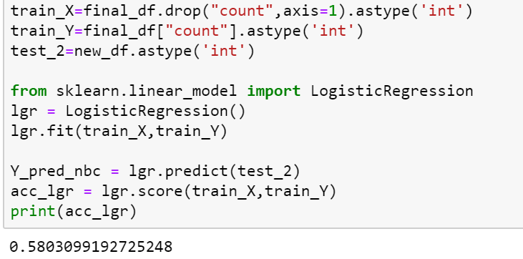
比較

Slide 36
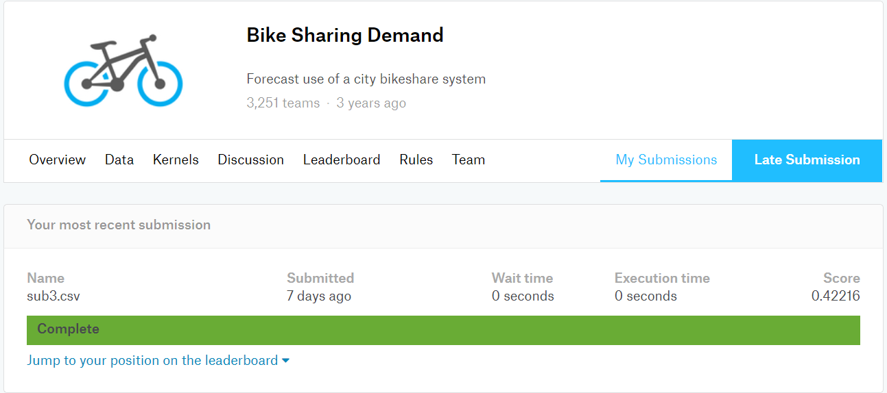
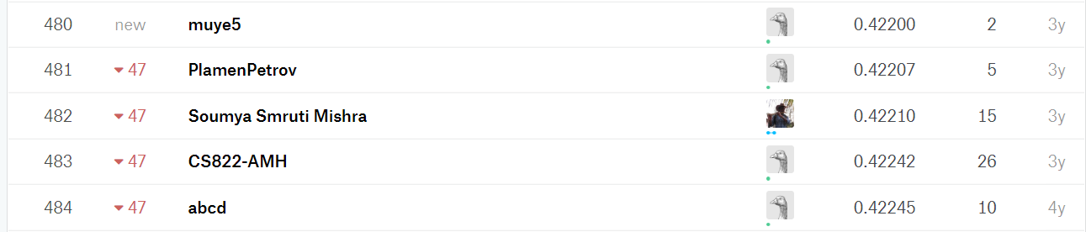
KAGGLE

